Slide 1
Open Source Platform and Network Administration
Lesson 10

Slide 3
Learning Objective
Examine the flexibility of various options with file permissions and filesystem settings and how granular control isolates data access.

Slide 4
Key Concepts
Linux filesystem hierarchy standard (FHS)
Filesystem mounting options
Remote filesystems
Filesystem encryption
Filesystem quotas

Slide 5
The Filesystem Hierarchy Standard
What is it?
What is the purpose?
Notes:
What is it?
A filesystem standard designed to be used by various distributions such as Fedora, Ubuntu, and Debian. It is also used by distributions that package software for installing to UNIX-like systems, such as Apache.
What is the purpose?
To have a uniform standard for all users. If each distribution followed a different standard then it would be difficult to work efficiently across various Linux distributions and to locate files that are necessary to run an application.

Slide 6
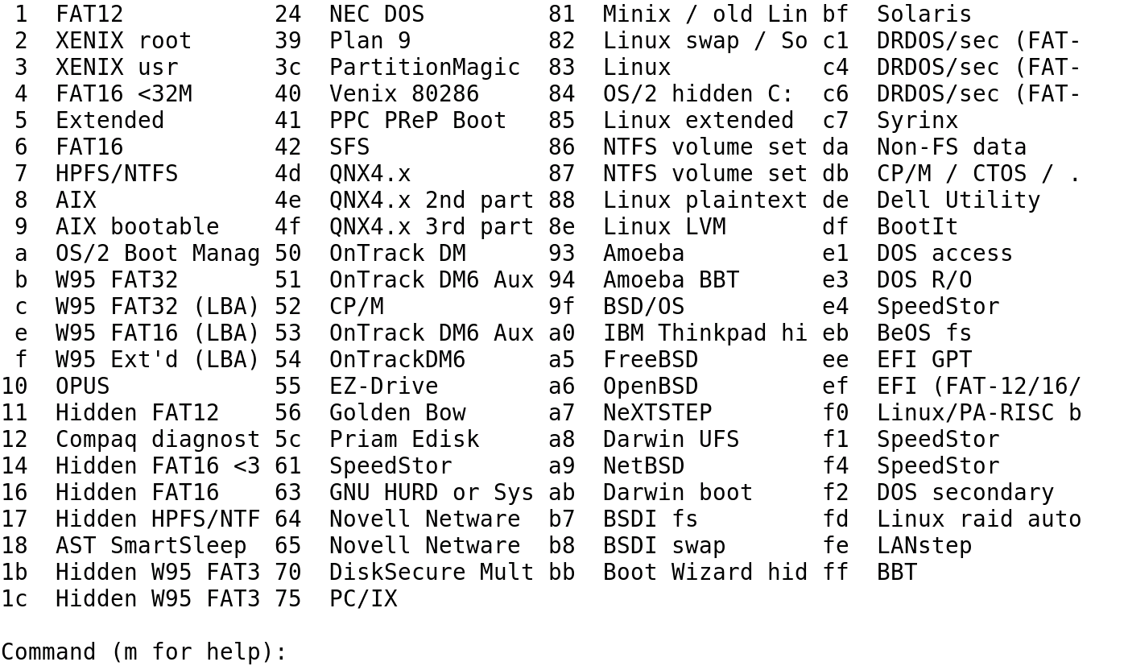
Linux Partition Type Identifiers

Slide 7
Securing the Linux Filesystem
Linux system administrator should:
Use binaries placed in /sbin/ directory.
Group files or create separate partitions for directories such as /var/, /home/, and /tmp/.
Isolate root account home directory from other users that are typically located in /home/<user>.

Slide 8
Filesystem Encryption
Encryption adds another layer of security for data that is considered confidential.
Documents such as customer personal information, social security numbers, credit card information, and business plans can be encrypted.
There are many regulations and laws for protecting consumer's personal data.

Slide 9
Filesystem Encryption Techniques
Kernel Space
Disk encryption subsystem (dm_Crypt)
Linux unified key setup (LUKS)
Loop-Advanced Encryption Standard (AES)
TrueCrypt
Enterprise cryptographic filesystem (eCryptfs)

Slide 10
Filesystem Encryption Techniques (Continued)
User Space
LUKS
Encrypted File System (EncFS)

Slide 11
Pros and Cons of Filesystem Encryption
Pros
Simple to implement
Cons
All data in filesystem is encrypted, including data you don’t want encrypted
Transparent to the user
Difficult to hack
Resizing the filesystem later is difficult

